Slide 1
Spence International Investments, LLC. et al. v. Republic of Costa Rica (ICSID Case No. UNCT/13/2)
Respondent’s Closing Argument

Slide 2
Claimants’ Conspiracy Theory
“At some point, it appears as though the two men decided to rope in a third accomplice: none other than the Minister of Environment and Energy, Carlos Manuel Rodríguez Echandi.”
(Claimants’ Memorial, para. 143)

Slide 3
Claimants’ Conspiracy Theory
“Staying true to Cedarena’s vision statement, the three men decided that Mr. Jurado would use his authority, as Attorney General, to issue a binding interpretation that would effectively read the “aguas adentro” amendment out of the 1995 Park Law – simply by labeling it as a typographical error.”
(Claimants’ Memorial, para. 145)

Slide 4
Claimants’ Conspiracy Theory
“This case is an example of an abuse of power because the intent of the law was rendered "ineficaz" ("ineffective") by changing the meaning of the term "aguas adentro,“ no matter if the coordinates mentioned in the law could allow a different interpretation. Whenever an official changes the meaning of a law to serve his own personal policy goals (such as expanding the size of a park, thereby causing so many unnecessary expropriations), he has committed an abuse of power. . . Article 168 of the Penal Code provides sanctions of imprisonment for up to 10 years for this kind of case ("corrupción agravada''). Nonetheless, the Government has apparently condoned Jurado's actions.”
(Ruiz’s Expert Report, pp. 13-14)

Slide 6
Time Line
2004
The Procuraduría issues legal opinion on clarified limits of Park
1991
Costa Rica creates Las Baulas National Park
December 2005
MINAE initiates expropriations of Claimants’ properties
2005
SETENA temporarily suspends environmental permits inside the Park
2003
First expropriation inside the Park
1991
1992
1993
1994
1995
1996
1997
1998
1999
2000
2001
2002
2003
2004
2005
2006
2007
2008
2009
1995
Costa Rica Congressional Law extends limits of Park to include Playa Ventanas
2008
Supreme Court orders permanent suspension of environmental permits inside the Park
2003-2007
Claimants purchase property inside the Park
2005
The Procuraduría
confirms
clarified limits of Park
Declarations of Public Interest (2005-2007)
Decrees of Expropriation (2006-2008)
Acts of Dispossession (2008)

Slide 7
Claimants Knew Their Properties Were Inside the Park and Were Going to be Expropriated
“Q. And when you saw the stamp later in 2005, you still had no doubt whatsoever that your property was outside of the Park?
This stamp in my mind shows that MINAE was of the opinion that it was in the Park. That was not my opinion.”
(Engl. Tr. 364:4-9) (Berkowitz)

Slide 8
Claimants Knew Their Properties Were Inside the Park and Were Going to be Expropriated
“Q. But when you saw it [the registry drawing] in 2006 before you purchased the property, did you understand that MINAE’s position in 2003 was the property was inside of the Park based on the ‘91 Decree?
Yes.”
(Engl. Tr. 319:1-18) (Reddy)

Slide 9
Claimants Knew Their Properties Were Inside the Park and Were Going to be Expropriated
“Q. So before you bought it, you knew MINAE had taken the position [on whatever legal basis—decree ’91—that the property was inside of the Park?]
Correct.
Q. And that was part of your due diligence?
Correct.
Q. And you bought the property nevertheless?
Correct.”
(Engl. Tr. 305:19-306:9) (Reddy)

Slide 10
Claimants Knew Their Properties Were Inside the Park and Were Going to be Expropriated
“Q. When you performed due diligence with respect to those four purchases, the views of the Procuraduría that the Park extended 125 meters inland did not play a role; correct?
No. It played a role, but we did our analysis to believe that this opinion would not stand, and we were still comfortable to go through with the purchase.”
(Engl. Tr. 288:10-289:9) (Reddy)

Slide 11
Claimants Knew Their Properties Were Inside the Park and Were Going to be Expropriated
“Q. So help me understand your due diligence then. You have a Declaration of Public Interest with respect to one of your properties, which says it will be expropriated. It initiates the expropriation process. And after that you purchase four more properties?
That's correct.”
(Engl. Tr. 282:10–16) (Reddy)

Slide 12
Claimants Knew Their Properties Were Inside the Park and Were Going to be Expropriated
“A: . . . I agree that MINAE was signaling to expropriate. I agree that they have the right to proceed to expropriate. I agree that I was informed that this process was starting, but you're asking me to state something that I'm unwilling to state, which is I did not believe at that time that my property was inside the Park. . .”
(Engl. Tr. 377:16-22) (Berkowitz)

Slide 13
Claimants Knew Their Properties Were Inside the Park and Were Going to be Expropriated
“Q. So, then, Mr. Berkowitz, isn't it correct that, in response to your formal application to MINAE in March of 2003, MINAE issued a resolution in June of 2003, and in that resolution, relating to the felling and pruning of trees, it also stated that the Las Baulas Park, under Decree of '91 and Law of '95, extends 125 meters inland from the high tide. Is that what MINAE said in that resolution --
Yes, that's what they said.”
(Engl. Tr. 382:15-383:2) (Berkowitz)

Slide 14
Claimants Knew Their Properties Were Inside the Park and Were Going to be Expropriated
“Q. So what do you understand by the phrase “in the private areas”? You’ve just suggested that there were no private areas.
They were referring to the private areas in the zone, the conflicted zone, the 75 meters.”
(Engl. Tr. 398:19-399:3) (Berkowitz)

Slide 15
Claimants Knew Their Properties Were Inside the Park and Were Going to be Expropriated
“Q. Is it correct, Mr. Berkowitz, that the document reflecting that transaction provided that you, as the purchaser, would not have a claim against the seller in case the properties were expropriated in the future?
That is correct.”
(Engl. Tr. 407:16-21) (Berkowitz)

Slide 16
Procedural History of Claimants’ Lots
Source: Annex 2 of Claimants’ Rejoinder on Jurisdiction, February 4, 2015

Slide 17
Claimants Knew Their Properties Were Inside the Park and Were Going to be Expropriated
“Q. So your testimony is that, within the 75 meters, issuing building permits stopped sometime in 2008?
A. Correct.
Q. And you've testified that you knew that?
Correct.”
(Engl. Tr. 295:2-7) (Reddy)

Slide 18
Claimants Knew Their Properties Were Inside the Park and Were Going to be Expropriated
Q. "In 2008, I was informed of the Supreme Court's decision by which pursuant to Article 50 of the Constitution, it ordered MINAE to initiate the expropriation proceedings of the private property within the Park and required it to pay compensation for any undue delay in the expropriation proceedings.“ You confirm that testimony, Mr. Berkowitz?
A. Yes.
Q. When in 2008 you were informed, do you recall? You were informed of the Supreme Court's decision?
A. I'm not certain whether I knew about it because it came in around Christmas, as I recall, and I believe I was on vacation. So, I'm not sure whether I knew about it around Christmas or whether I--when I came back in January. But thereabouts, within that 30-day period, I knew about it.
Q. Okay. Have you actually seen it and reviewed it, or you were just informed of it?
A. I was informed of it. It's in Spanish. It's a bit technical. I do read Spanish, but it is somewhat technical.
Q. Were you informed also, then, that same Supreme Court decision also ordered a definite suspension of the environmental permits inside the Park?
I was informed. I was so informed.”
(Engl. Tr. 438:1-439:5) (Berkowitz)

Slide 19
Categories of Properties
Category 1: No Declaration of Public Interest has been issued. Eight properties fall into this category. Lots A39, SPG3, C71, C96, V59, V61a, V61b and V61c
Category 2: Declaration of Public Interest has been issued, but no Decree of Expropriation has been issued. These are the properties where expropriation procedures were suspended at the administrative stage, before the properties were transferred to the judicial stage. Nine properties fall into this category. Lots V30, V31, V32, V33 V38, V39, V40, V46, V47
Category 3: Decree of Expropriation has been issued, and thus the properties are at a judicial stage. Nine properties fall into this category. Lots A40, SPG1, SPG2, B1, B3, B5, B6, B7, and B8
17

Slide 20
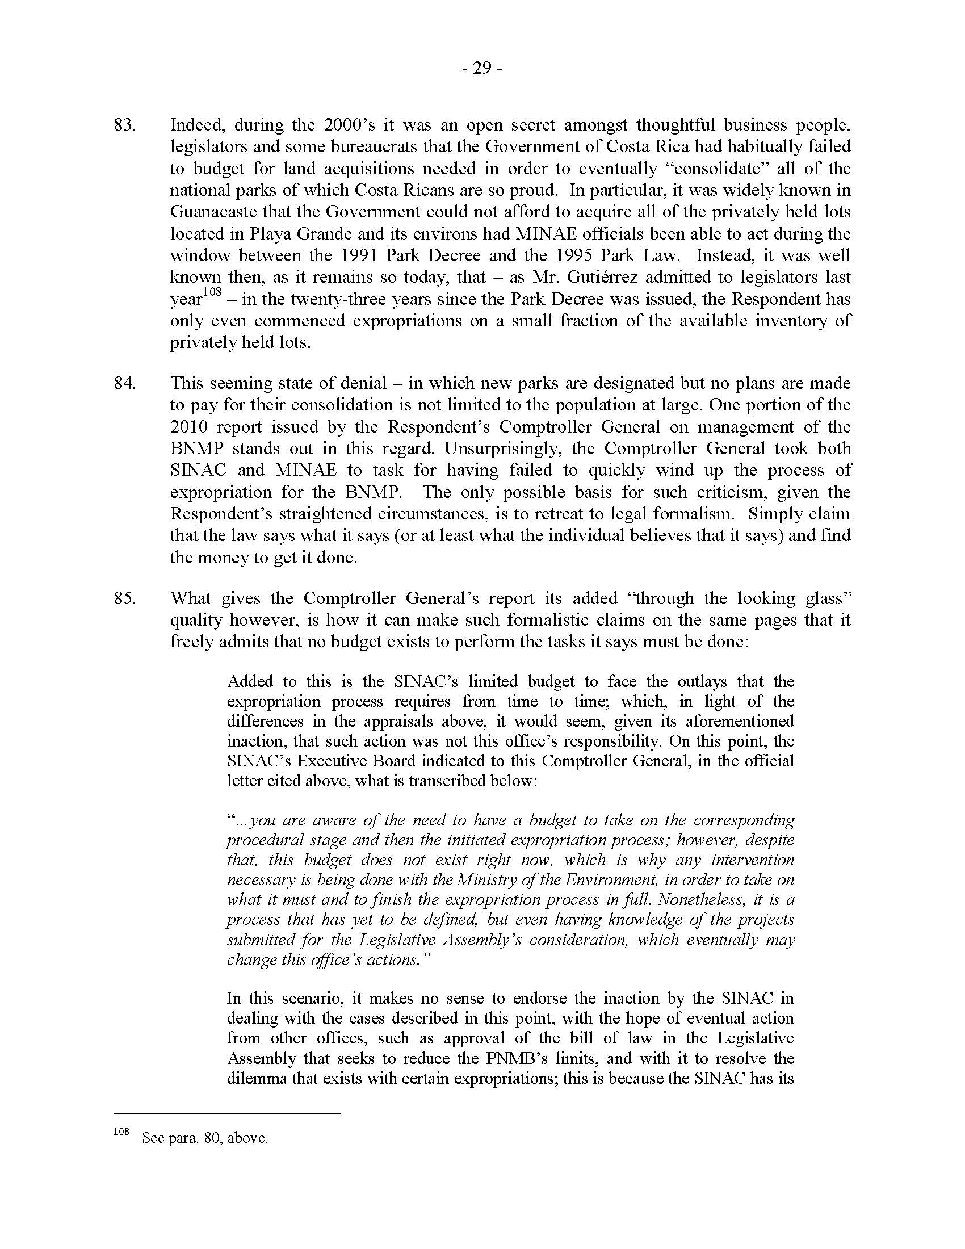
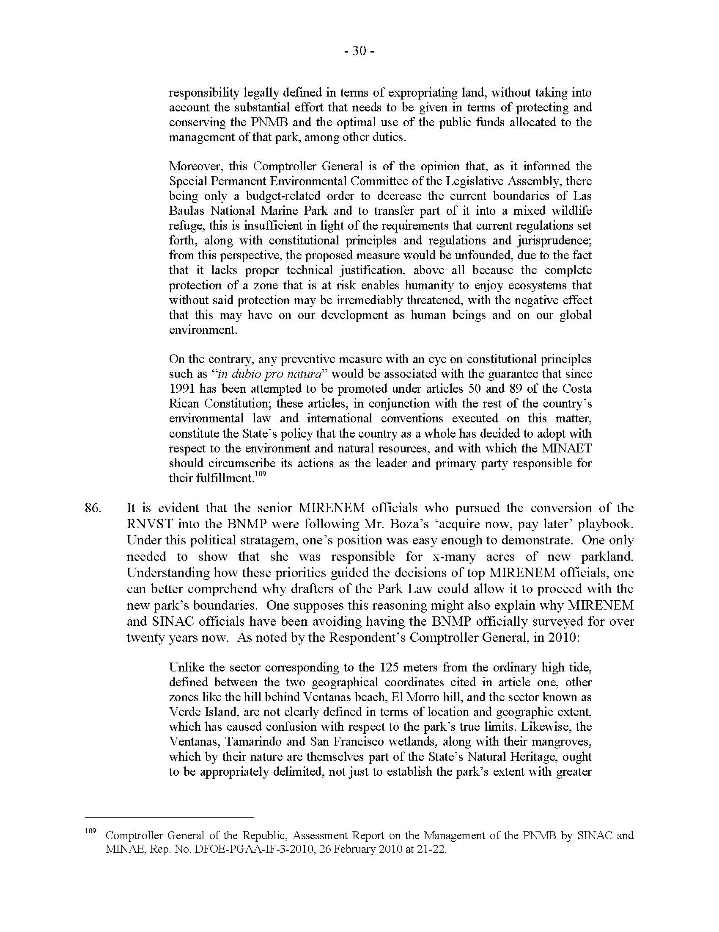
Contraloría

Slide 21
Procedural History of Claimants’ Lots
Source: Annex 2 of Claimants’ Rejoinder on Jurisdiction, February 4, 2015

Slide 22
Expiration of Decree of Public Interest
“Q. In direct examination, Doctora, Ms. McCandless asked you what happens in the event that a Decree of Expropriation is not issued within a year of the Decree of Public Interest. And I understood your answer to be that it expires; is that correct?
Yes. It expires on its own. It ceases to have any value.”
(Engl. Tr. 659:1-8) (Chaves)

Slide 23
Claimants’ Claims Fall Outside the Tribunal’s Jurisdiction
“Thus, commencing with the Constitutional Court’s decision in May 2008 directing MINAE to expropriate the land and concluding with the Constitutional Court’s clarification of 27 March 2009, the Respondent completed the creeping expropriation of the rest of the Claimants’ properties.”
(Claimants’ Memorial at para. 213)
“[T]he Respondent has maintained measures tantamount to expropriation of most of the Claimants’ investments, which began with a decision of the Constitutional Court, rendered on 23 May 2008 and crystallized with an [order] of the Minister for MINAE on 19 March 2010, in which he ordered his staff to terminate all pending environmental viability permit applications, and never accept another, for lots deemed to [be] inside of the BNMP’s 125 Meter restricted zone.”
(Claimants’ Memorial at para. 192)
“[T]he answer to the question of when the composite impact of Respondent’s measure substantially deprived the Claimants of their use and enjoyment of their property rights and interests in their investments was on or about 19 March 2010”
(Claimants’ Memorial at para. 221)
As indicated above, nine of the Claimants’ lots have been subjected to direct expropriation, effected by the Respondent when it transferred title in each respective lot to itself, from an enterprise owned and controlled a Claimant. All such direct expropriations either took place as part of the ongoing exercise of the Respondent’s municipal expropriation regime having reached the appropriate stage or as a result of a Claimant filing a waiver with the Court in order to participate in the instant arbitration. . . . Consistent with customary international law practice, it is at that point that the State takes possession of the land, thereby satisfying the customary requirements of a direct taking.
(Claimants’ Memorial on the Merits at paras. 206-207)

Slide 24
Mondev Award
“In this respect it should be noted that Article 1110 requires that the nationalization or expropriation be ‘on payment of compensation in accordance with paragraphs 2 through 6.’ The word ‘on’ should be interpreted to require that the payment be clearly offered, or be available as compensation for taking through a readily available procedure, at the time of the taking.”
(Mondev Int’l LTD v. United States of America, ICSID Case No. ARB(AF)/99/2, Award, ¶ 72 (11 October 2002).

Slide 25
Claimants’ Financial Benefit
“Q. Mr. Berkowitz, half a million colones, would that be about, give or take, $1,000?
A. That's correct.
Q. And if the administrative appraisal is 20 million, give or take, in some cases above 20 million, in some cases just below 20 million colones, then the administrative appraisal is about 40 times higher than the purchase price; is that correct?
Forty times higher than what the purchase price was registered.”
(Engl. Tr. 430:13-19) (Berkowitz)

Slide 26
Costa Rica’s Conservation Efforts
“Q. What you're saying is, urban development may be harmful to the nesting of the turtles, and, in fact, in most cases, is unless it is careful and strictly controlled. Is that generalization more or less correct?
It's very close to being correct, yes.”
(Engl. Tr. 471: 5-10) (Rusenko)
“Q. . . as I understand from your testimony, you do agree that expropriating private property within the 75 meters is a measure that does protect the turtles?
That's correct.”
(Engl. Tr. 472: 14-18) (Rusenko)
“Q. Do you have any reason to doubt, Dr. Rusenko, that the Government of Costa Rica was willing and interested in making a genuine effort to protect the turtles?
No, I don't.”
(Engl. Tr. 475: 4-8) (Rusenko)

Slide 27
Article 17.2 of CAFTA
Article 17.2: Enforcement of Environmental Laws
1. (a) A Party shall not fail to effectively enforce its environmental laws, through a sustained or recurring course of action or inaction, in a manner affecting trade between the Parties, after the date of entry into force of this Agreement.
(b) The Parties recognize that each Party retains the right to exercise discretion with respect to investigatory, prosecutorial, regulatory, and compliance matters and to make decisions regarding the allocation of resources to enforcement with respect to other environmental matters determined to have higher priorities. Accordingly, the Parties understand that a Party is in compliance with subparagraph (a) where a course of action or inaction reflects a reasonable exercise of such discretion, or results from a bona fide decision regarding the allocation of resources.
2. The Parties recognize that it is inappropriate to encourage trade or investment by weakening or reducing the protections afforded in domestic environmental laws. Accordingly, each Party shall strive to ensure that it does not waive or otherwise derogate from, or offer to waive or otherwise derogate from, such laws in a manner that weakens or reduces the protections afforded in those laws as an encouragement for trade with another Party, or as an encouragement for the establishment, acquisition, expansion, or retention of an investment in its territory.

Slide 28
Damages
“Q….[G]iven the difficulty or the challenge that you faced, do you think it’s fair to say that different—people could come up with different conclusions of the valuation for properties in the area?
. . .
A. Yes, Professional valuers often come up with different opinions of value.”
(Engl. Tr. 791:17-22 to 792:1-3) (Hedden)

Slide 29
Claimants’ Financial Gain
“A. So, besides the legal side, the real estate market here was just absolutely booming, you know, skyrocketing. And so these properties were growing in value at an exponential pace. We thought we were in early, and so we thought it was still a good investment opportunity for us to buy at that time.”
(Engl. Tr. 284:5-10) (Berkowitz)

Slide 30
Claimants’ Financial Gain
“President Bethlehem: Yes. Was there in your mind at the time any appreciation that purchasers coming after you, those to whom you may have wanted to sell the property, would not have had the same robust confidence that you had in your interpretation of the 1991 Decree and the 1995 Law?
The Witness: You know, I don't think I tried to put myself in their mind. It was very clear to us that we were buying private property titled to the 50-meter line that, that we'd maintain full use and enjoyment of that private property, that the Park extended seaward. So I had no issue with that. Any buyer would be represented by a Costa Rican attorney and would get their advice and make their own decision.”
(Engl. Tr. 339:13 to 340:5) (Berkowitz)

Slide 31
Claimants’ Financial Gain
“For me, it was a very positive factor that we were bordering a Park and that the turtles laid their nest in front of our land. It was--to me it--I was had already had inquiries from one Hollywood magnate to purchase the property. This is just the type of client that we had envisioned.”
(Engl. Tr. 350:9-14) (Berkowitz)

Slide 32
Relevant Purchase and Sale Agreements
“Q….And you would agree, would you not, that sales and purchase contracts contain and can contain useful information about the specific terms of a particular sale?
Yes.”
(Engl. Tr. 783:11-15) (Hedden)

Slide 33
Damages
“Q…. ARBITRATOR KANTOR: I've seen proposed, in connection with valuations, in circumstances where comparables are not available and the property does not lend itself to an income method . . . . The one means of estimating Fair Market Value in those circumstances would be to identify the original purchase price and then seek to calculate over the duration of the entire period. . . an average Rate of Return on that profit. . . Is that approach for which data is or could be obtained for these properties, in your professional view?
Yes. I believe that again, relative to these specific properties, I believe it would be very difficult, . . . but, yes, it is done. It’s done with fixed assets. It’s done with other types of asset classes.”
(Engl. Tr. 839:16 to 840:19) (Hedden)

Slide 34
Damages
“Q. If you had the understanding that—if you knew that those Lots behind the B Lots that are shown in this picture here belonged to Mr. Berkowitz, would you feel the need to adjust your severance value to reflect it more along the lines of what you did wit the SPG Lots because, in that instance, there would be unity of title and unity of ownership?
I would have to take that under advisement. But if it met the test of unity in use, unity of title, and the physical continuity and they weren’t separated and could in fact be joined, they would get similar treatment then to the SPG Lots and/or, you know, how I ascribed a value to B Lots 5 and 6, where they were adjoining and could be assembled to create one plus or minus 8,000 square foot Lot.”
(Engl. Tr. 814:4-18) (Hedden)

